Slide 1
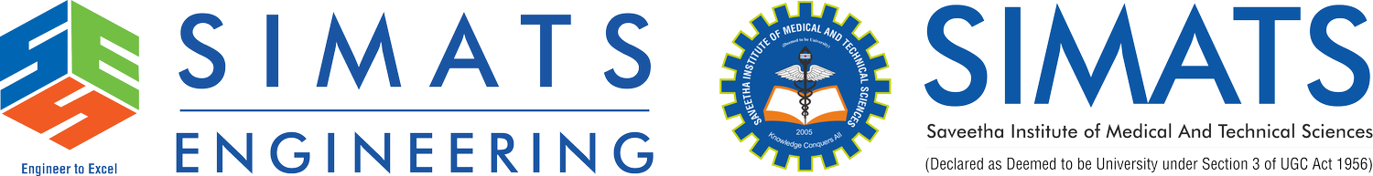
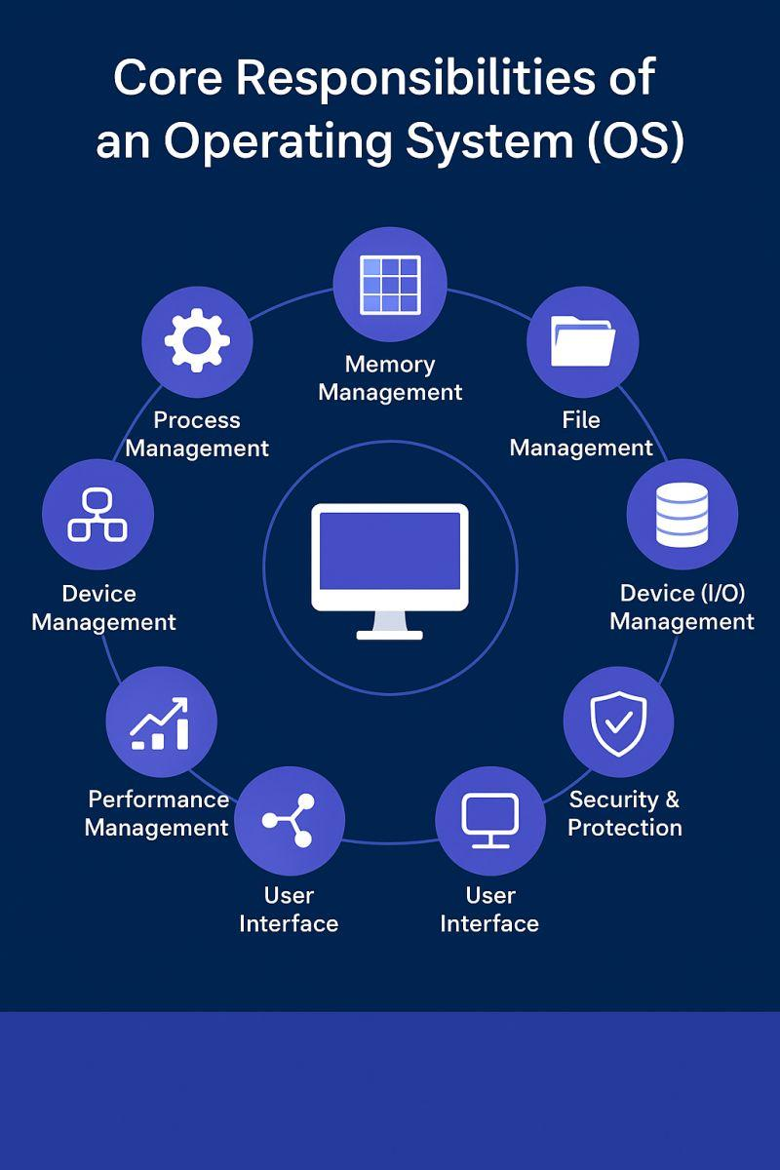
Operating System Functions Process Scheduling, Memory Management & I/O Operations
CSA0401 – Operating Systems
Guided by
Ruby Elizabeth J
Presented by:
Yashmita G [192511032]
1

Slide 2


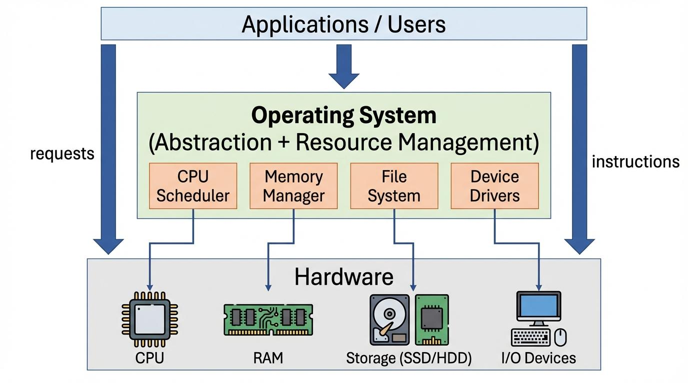
Introduction to Operating System
What is an Operating System?
An Operating System (OS) is system software that acts as an interface between the user and computer hardware. It manages hardware resources and provides services to application programs.
Main Functions
Process Management
Memory Management
File Management
I/O Device Management
Security
Resource Allocation
Example
When you open Google Chrome, the OS:
Loads Chrome into memory.
Allocates CPU time.
Reads files from storage.
Displays output on the monitor.

Slide 3
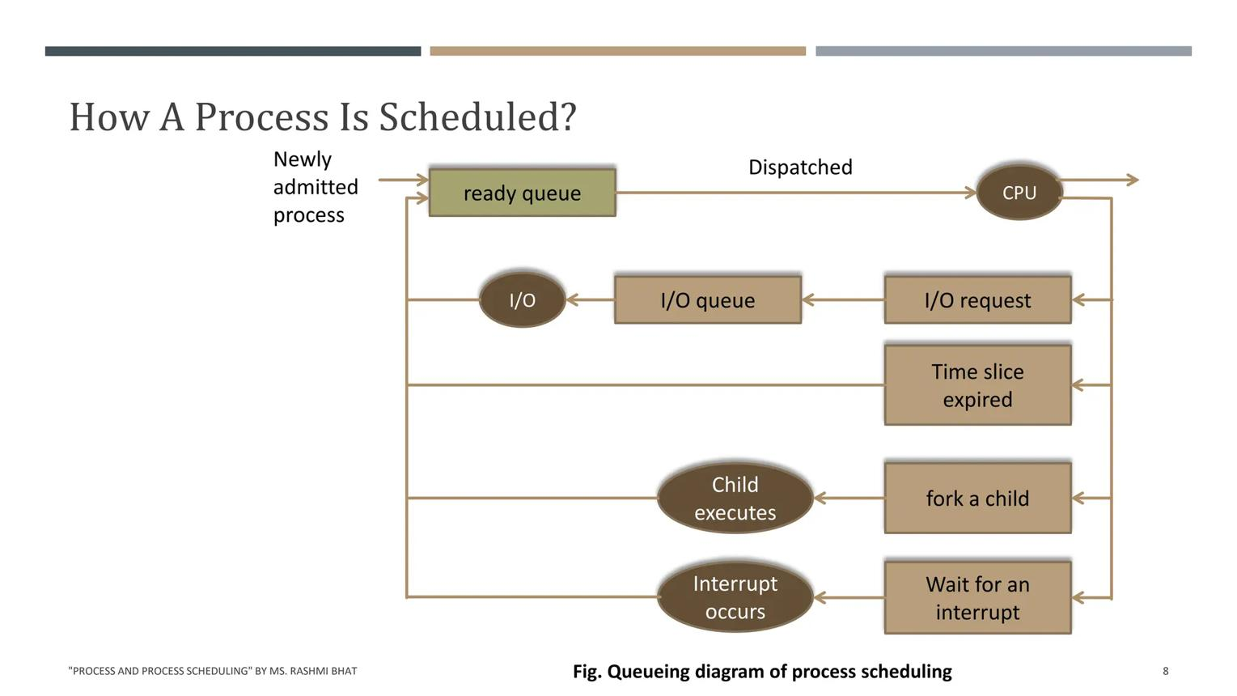
Process Scheduling
What is Process Scheduling?
Process Scheduling is the technique used by the OS to decide which process gets the CPU and for how long.
Objectives
Maximum CPU Utilization
Faster Response Time
Fair Resource Sharing
Higher Throughput
Example
Three applications are running:
Chrome
Spotify
VS Code

Slide 4
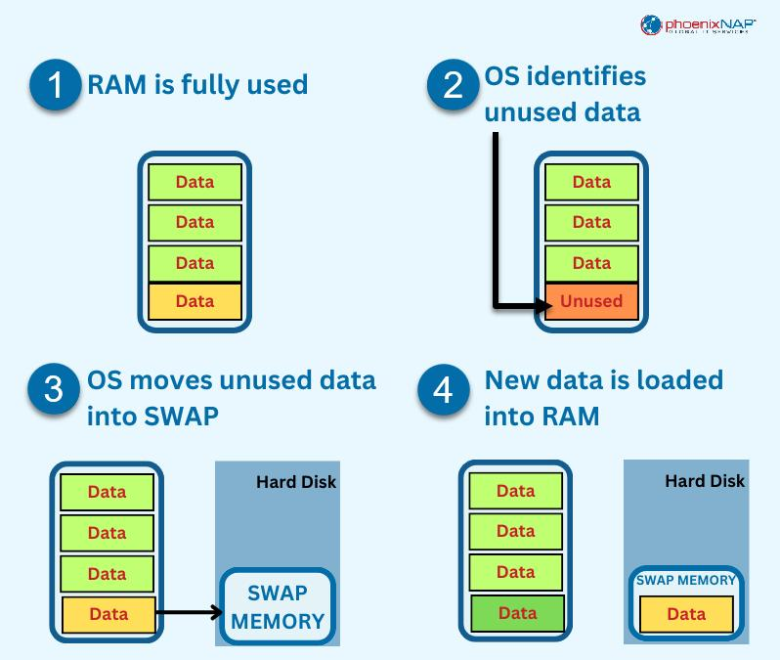
Memory Management
What is Memory Management?
Memory Management is the process of allocating and deallocating RAM efficiently.
Responsibilities
Memory Allocation
Memory Protection
Virtual Memory
Paging
Swapping
Example
Chrome uses 800 MB RAM.
Photoshop uses 2 GB RAM.
The OS allocates memory separately to both applications.

Slide 5
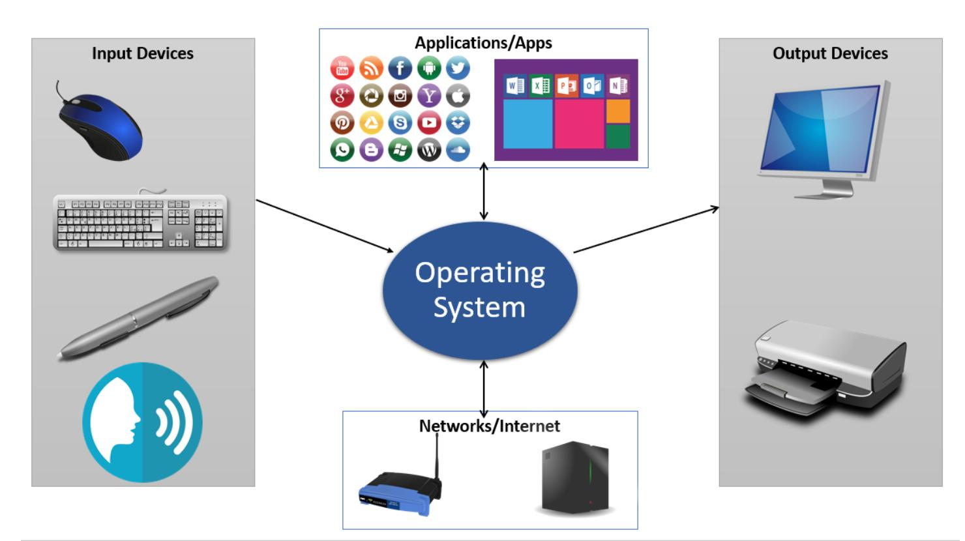
I/O Operations
What are I/O Operations?
Input/Output operations allow communication between the CPU and peripheral devices.
Input Devices
Keyboard
Mouse
Scanner
Output Devices
Monitor
Printer
Speaker

Slide 6
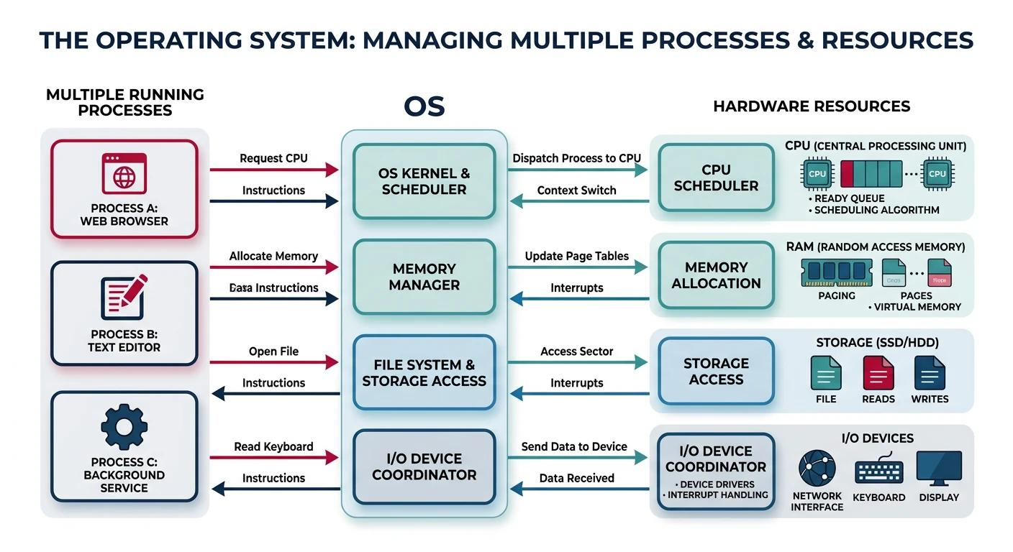
Interaction Between OS Components
When a user opens Microsoft Word:
Step 1
Process Scheduler gives CPU time.
↓
Step 2
Memory Manager allocates RAM.
↓
Step 3
File System loads Word files.
↓
Step 4
I/O Manager receives keyboard and mouse input.
↓
Step 5
Display Manager shows output on the monitor.

Slide 7
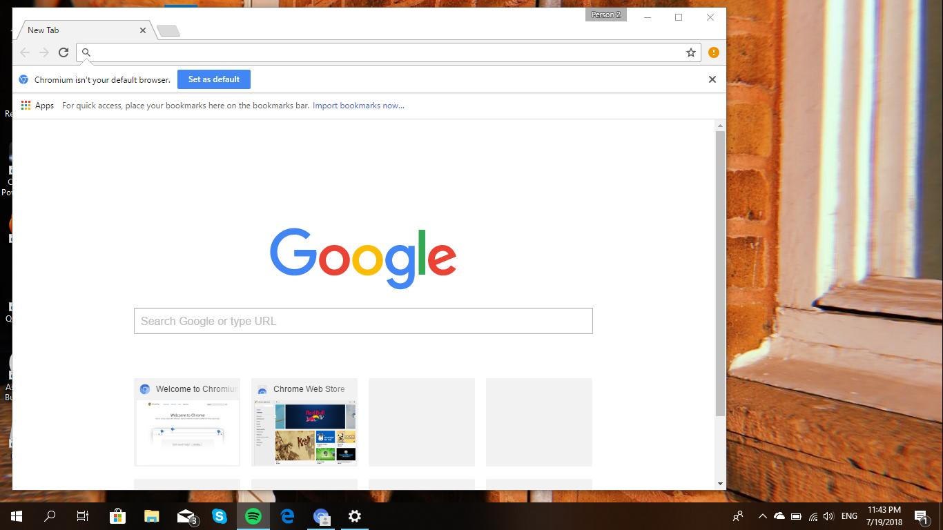
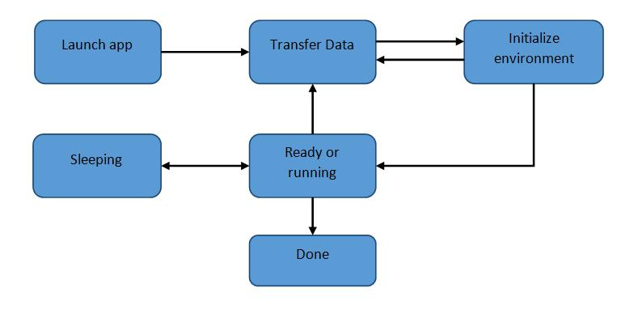
Real-Life Example
Opening Google Chrome
Double Click Chrome
↓
OS Creates Process
↓
Memory Allocated
↓
Chrome Files Loaded
↓
Keyboard & Mouse Enabled
↓
Webpage Displayed

Slide 8
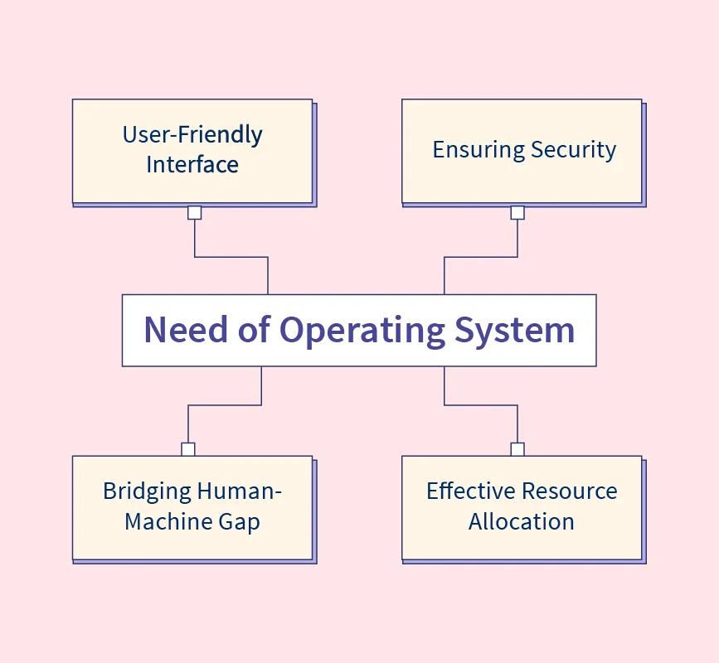
Advantages
Benefits of Operating System Functions
✔ Efficient CPU Utilization
✔ Better Memory Usage
✔ Faster Execution
✔ Resource Sharing
✔ Device Management
✔ Improved Security

Slide 9
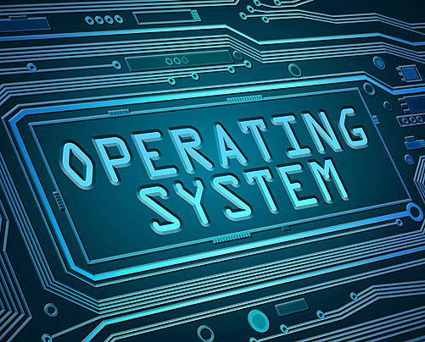
Conclusion
The Operating System is the foundation of a computer system that manages hardware and software resources efficiently. It performs essential functions such as process scheduling, memory management, and I/O operations, ensuring smooth multitasking and optimal system performance. Through system calls, applications communicate securely with the operating system, making computing reliable, efficient, and user-friendly.
Key Takeaways
Acts as an interface between the user and hardware.
Manages processes, memory, and I/O devices.
Enables efficient resource utilization.
Uses system calls for application–OS communication.
Ensures smooth, secure, and reliable system performance.

Slide 10

System Calls

